Slide 1

Data Science for Case Law
Group 45:
Gufran pathan | prerna Aggarwal | Fernando medeiros

Slide 2
Problem Statement
Headnotes are brief case summary statements for court cases. They are generated by commercial third parties. They are usually under copyright protection and may not be available or may be subject to usage restrictions.
In this project we will use NLP summarized algorithms to reconstruct headnotes using a variety of court cases as our training dataset.
We have used for training, the dataset for historical court cases provided by the CaseLaw Access Project. We have selected cases for the state of North Carolina from the Harvard Law School Library

Slide 3
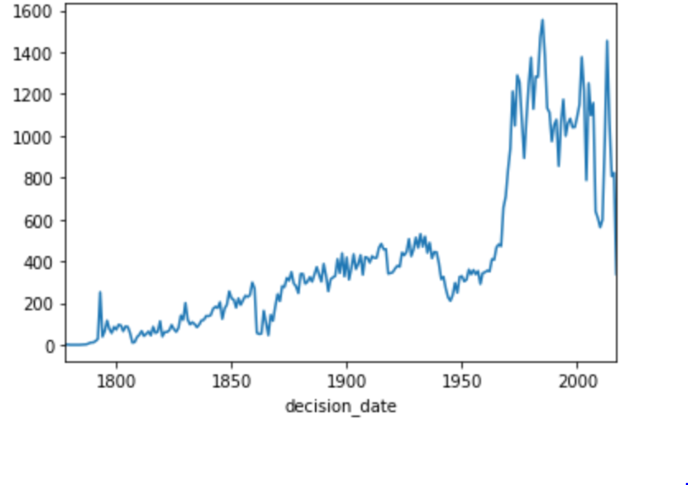
Exploratory Data Analysis
Data: We are using the dataset provided by the CaseLaw Access Project. We have selected cases for the state of North Carolina from the Harvard Law School Library.
Data Format | json
Number of Cases | 97,600 (using 3,693 cases)
Number of Columns | 32
Relevant Columns | casebody.data
casbody.data structure | xml
Relevant casebody columns | headnotes and opinions
Number of cases by year

Slide 4
Preparing the data
The steps to prepare the data for our models:
Selected cases since 2008 and extract data from casebody.data
Extracted majority opinions and headnotes from casebody.data
Removed ‘\n’ from the opinions
Filtered data where length of headnotes > 150 and opinion is larger than the headnotes
Tokenized the headnotes and opinions
Preprocessed using Bert preprocessor to label opinions.
Split data into training, testing, and validation sets

Slide 5
Steps for labeling data
The steps to prepare the data for our models:
For each sentence in opinion and compare it to the sentences in the headnotes.
If the sentence increases the rouge score, select the sentence for the summary.
Label the tokenized opinion so that the sentences that are selected have a label of 1 and the sentence that is not selected has a label of 0
Additional columns created are for each opinion
The starting index of each sentence
The rank of each word in an opinion

Slide 6
Our Research (criteria)
We searched for existing models that generate summaries based on the following criteria
Generate Extractive summaries since they can generate semantically and grammatically correct sentences these models need less resources and understanding of the domain.
Summarize long documents
Perform well as measured by the ROGUE (Recall-Oriented Understudy for Gisting Evaluation) Metric Score.
Can be implemented in the given time constraint

Slide 7
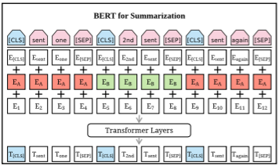
Our Research (PreSumm)
Text Summarization with Pretrained Encoders
by Yang Liu and Mirella Lapata
This model uses BERT for text summarization and propose a general framework for extractive models. This is a document-level encoder based on BERT which is able to express the semantics of a document and obtain representations for its sentences. Several inter sentence transformer layers are stacked over the BERT encoder. This model produces extraction based summaries
This model can also produce abstraction based summary. This model uses new fine-tuning schedule adopting different optimizers for the encoder and the decoder as a means of alleviating the mismatch between the two (the former is pretrained while the latter is not). It takes as input the summaries provided by the extraction based model.
code is available at https://github.com/nlpyang/PreSumm

Slide 8
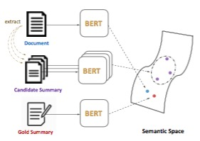
Our Research (MatchSum)
Extractive Summarization as Text Matching
by By Ming Zhong, Pengfei Liu, Yiran Chen, Danqing Wang, Xipeng Qiu, and Xuanjing Huang
This method performs Semantic text matching to estimate semantic similarity between a source and a target text fragment. It is trained on the CNN/ Daily Mail dataset and uses a Siamese-BERT(Bidirectional Encoder Representations from Transformers) architecture to compute the similarity between several candidate summaries to the source document and seledt the best candidate summary.
A Siamese networks consists of two identical neural networks, each taking one of the two input inputs. The last layers of the two networks are then fed to a contrastive loss function , which calculates the similarity between the two inputs.
Siamese BERT leverages the pre-trained BERT in a Siamese network structure to derive semantically meaningful text embeddings that can be compared using cosine-similarity.
The Siamese network is also used in a similar way usinf the RoBERTa pretrained model
Code from https://github.com/maszhongming/MatchSum
Extractive Summarization as Text Matching

Slide 9
Our Research (metrics)
ROUGE METRICS
ROUGE (Recall-Oriented Understudy for Gisting Evaluation) is a set of metrics that can be used by NLP algorithms to evaluate the summaries it generates against a set of references (human-produced summary).
The ROUGE SCORES and METRICS are:
Metrics Name | Metrics Definition
ROUGE-1 | overlap of unigram (each word) between the system and reference summary
ROUGE-2 | overlap of bigram (two words) between the system and reference summary
ROUGE -L | Longest Common Subsequence (LCS). identifies longest co-occurring in sequence n-grams automatically to measure sentence level similarity
Recall | the number of overlapping words divided by the total words in the reference summary
Precision | the number of overlapping words divided by the total number of words in the generated summary
F-Measure | Assigned by equal importance of recall and precision, i.e. alpha=0.5

Slide 10
Implementation
SOTA | Type | Transformer | Steps
PreSumm | Extractive | BERT | Use the pretrained model with our dataset and get the ROUGE metrics Train the model with our dataset Use the trained model to get the ROUGE metrics Compare the two outputs
 | Abstractive | Baseline Transformer | Use the pretrained model with our dataset and get the ROUGE metrics Train the model with our dataset Use the trained model to get the ROUGE metrics Compare the two outputs
 |  | BERT | Use the pretrained model with our dataset and get the ROUGE metrics Train the model with our dataset Use the trained model to get the ROUGE metrics Compare the two outputs
MatchSum | Extractive | BERT | Train the model with our dataset Use the trained model to get the ROUGE metrics
 |  | RoBERTa | Train the model with our dataset Use the trained model to get the ROUGE metrics

Slide 11
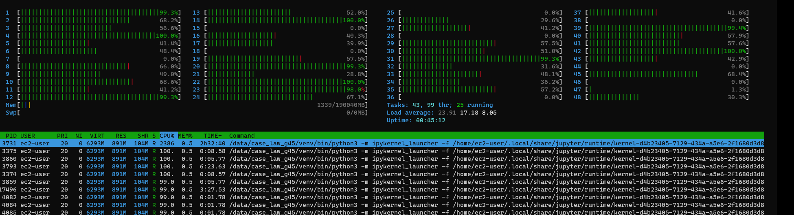
train.py’s contribution to global warming!

Slide 12
Our Results (F-Scores)
SOTA | Type | Transformer | Pre-trained |  |  | Trained
 |  |  | ROUGE-1 | ROUGE-2 | ROUGE-L | ROUGE-1 | ROUGE-2 | ROUGE-L
PreSumm | Extractive | BERT | 0.29475 | 0.11580 | 0.25311 | 0.30204 | 0.12198 | 0.26038
 | Abstractive | Baseline Transformer | 0.24971 | 0.07703 | 0.21326 | 0.27616 | 0.11064 | 0.23477
 |  | BERT | 0.24623 | 0.07836 | 0.21218 | 0.29275 | 0.10662 | 0.24970
MatchSum | Extractive | BERT | 0.44129 | 0.31916 | 0.40957 | - | - | -
 |  | RoBERTa | 0.52943 | 0.39246 | 0.49484 | - | - | -

Slide 13
Sample Results (MatchSum)
Actual Headnote:
employer and employee -- non-compete agreement -- client-based -- unreasonable the trial court correctly granted defendant 's motion for a dismissal under n.c.g.s. § 1a-1 , rule 12 ( b ) ( 6 ) of an action arising from a non-compete agreement where the client-based territorial restriction and the five-year time limitation in the agreement were unreasonable .although a five-year time restriction may be upheld , it must be considered with its geographical scope .here , the physical scope of the territorial restriction is irrelevant , but the substitution of the client base is unreasonable because it prevents defendant from working for all of plaintiff 's current or recent clients , regardless of location , so that he is precluded from working with a number of businesses in a large number of cities throughout the world .considering the relatively small number of plaintiff 's clients with whom defendant worked , the scope is extreme .furthermore , the restriction is unduly vague.
Generated Headnote:
the covenant in question prevents mr. baskin from working for all of farr 's current or recent clients , regardless of where the client is located , whether he had any contact with them , or whether he even knew about them .the scope of the covenant is extreme , considering that mr. baskin only worked with a relatively small number of farr 's clients .

Slide 14
Sample Results (PreSumm)
Actual Headnote:
the trial court lacked jurisdiction to extend defendants period of probation , we arrest judgment and vacate the order modifying probation and imposing sentence<q>on 21 july 2008 , defendant pled guilty to six counts of breaking or entering a motor vehicle and , in a combined judgment , was sentenced to two consecutive terms of six to eight months each<q>defendants probation expiration date was 20 july 2010 . on 1 march 2010 , defendants probation officer filed two new probation violation reports in the office of the clerk of superior court .
Generated Headnote (Abstractive):
probation and parole lack of jurisdiction judgment arrested order vacated the trial court lacked jurisdiction to extend defendants period of probation .<q>judgment was arrested and the order modifying probation and imposing sentence was vacated .
Non-sensical
Non-sensical

Slide 15
Next Steps
Tuning the different hype parameters
Expanding the sentence length beyond the fixed limit of 512
Using all the cases
Using all the opinions

Slide 16
Conclusion
For the PreSumm model, based on the ROUGE score we observe
The extractive model performs better than the abstractive based model
The trained model performs slightly better than the pretrained model
For the MathSum model , based on the ROUGE score we observe
RoBERTa model performs better than the BERT model
Over all the MathSum model performed better than the PreSumm model
This is also evident from samples of headnotes that we saw where we can find more sentences match the headnotes when we use the MathSum model than when we use the PreSumm model
The MathSum RoBERTa model performed the best

Slide 17
Appendix
Types of Summarizations
Extraction-based summarization: Content is extracted from original document and is not modified. This method will extract key phrases or sentences to form a summary. The summary generated by this method may not be the same format as a human might express it and the sentences may appear disjointed
Abstraction-based summarization: Abstractive methods generate a summary based on internal semantic representation of the original content, closer to what a human might express. Abstraction may transform the extracted content. Such transformation are computationally very challenging , involving both NLP (natural language processing) and a deep understanding of the document

Slide 18
Appendix
BERT (Bidirectional Encoder Representations from Transformers )
BERT is a NLP technique developed by Google(published in 2018 by Jacob Devlin and his colleagues) which can be used to created pretrained language models. This technigque hae reently been used to create pretrained models for a wide range of natural language processing tasks. BERT is a deeply bidirectional, unsupervised language representation and these models are pre-trained using only a plain text corpus. BERT uses a masking stategy and learns to predict masked sections within the text
RoBERTa(Robustly Optimized BERT Pretraining Approach)
RoBERTa builds on BERT’s language masking strategy. It modifies key hyperparameters in BERT, removing BERT’s next-sentence pretraining objective, and training with much larger mini-batches and learning rates. This allows RoBERTa to improve on the masked language modeling objective compared with BERT and leads to better downstream task performance.

Slide 19
Bibliography
Extractive Summarization as Text Matching Ming Zhong∗ , Pengfei Liu∗ , Yiran Chen, Danqing Wang, Xipeng Qiu† , Xuanjing Huang Shanghai Key Laboratory of Intelligent Information Processing, Fudan University.
Text Summarization with Pretrained Encoders Yang Liu and Mirella Lapata Institute for Language, Cognition and Computation School of Informatics, University of Edinburgh

